Slide 1
HPC for Research
CMC Summer Research Computing Bootcamp
June 9, 2025

Slide 2
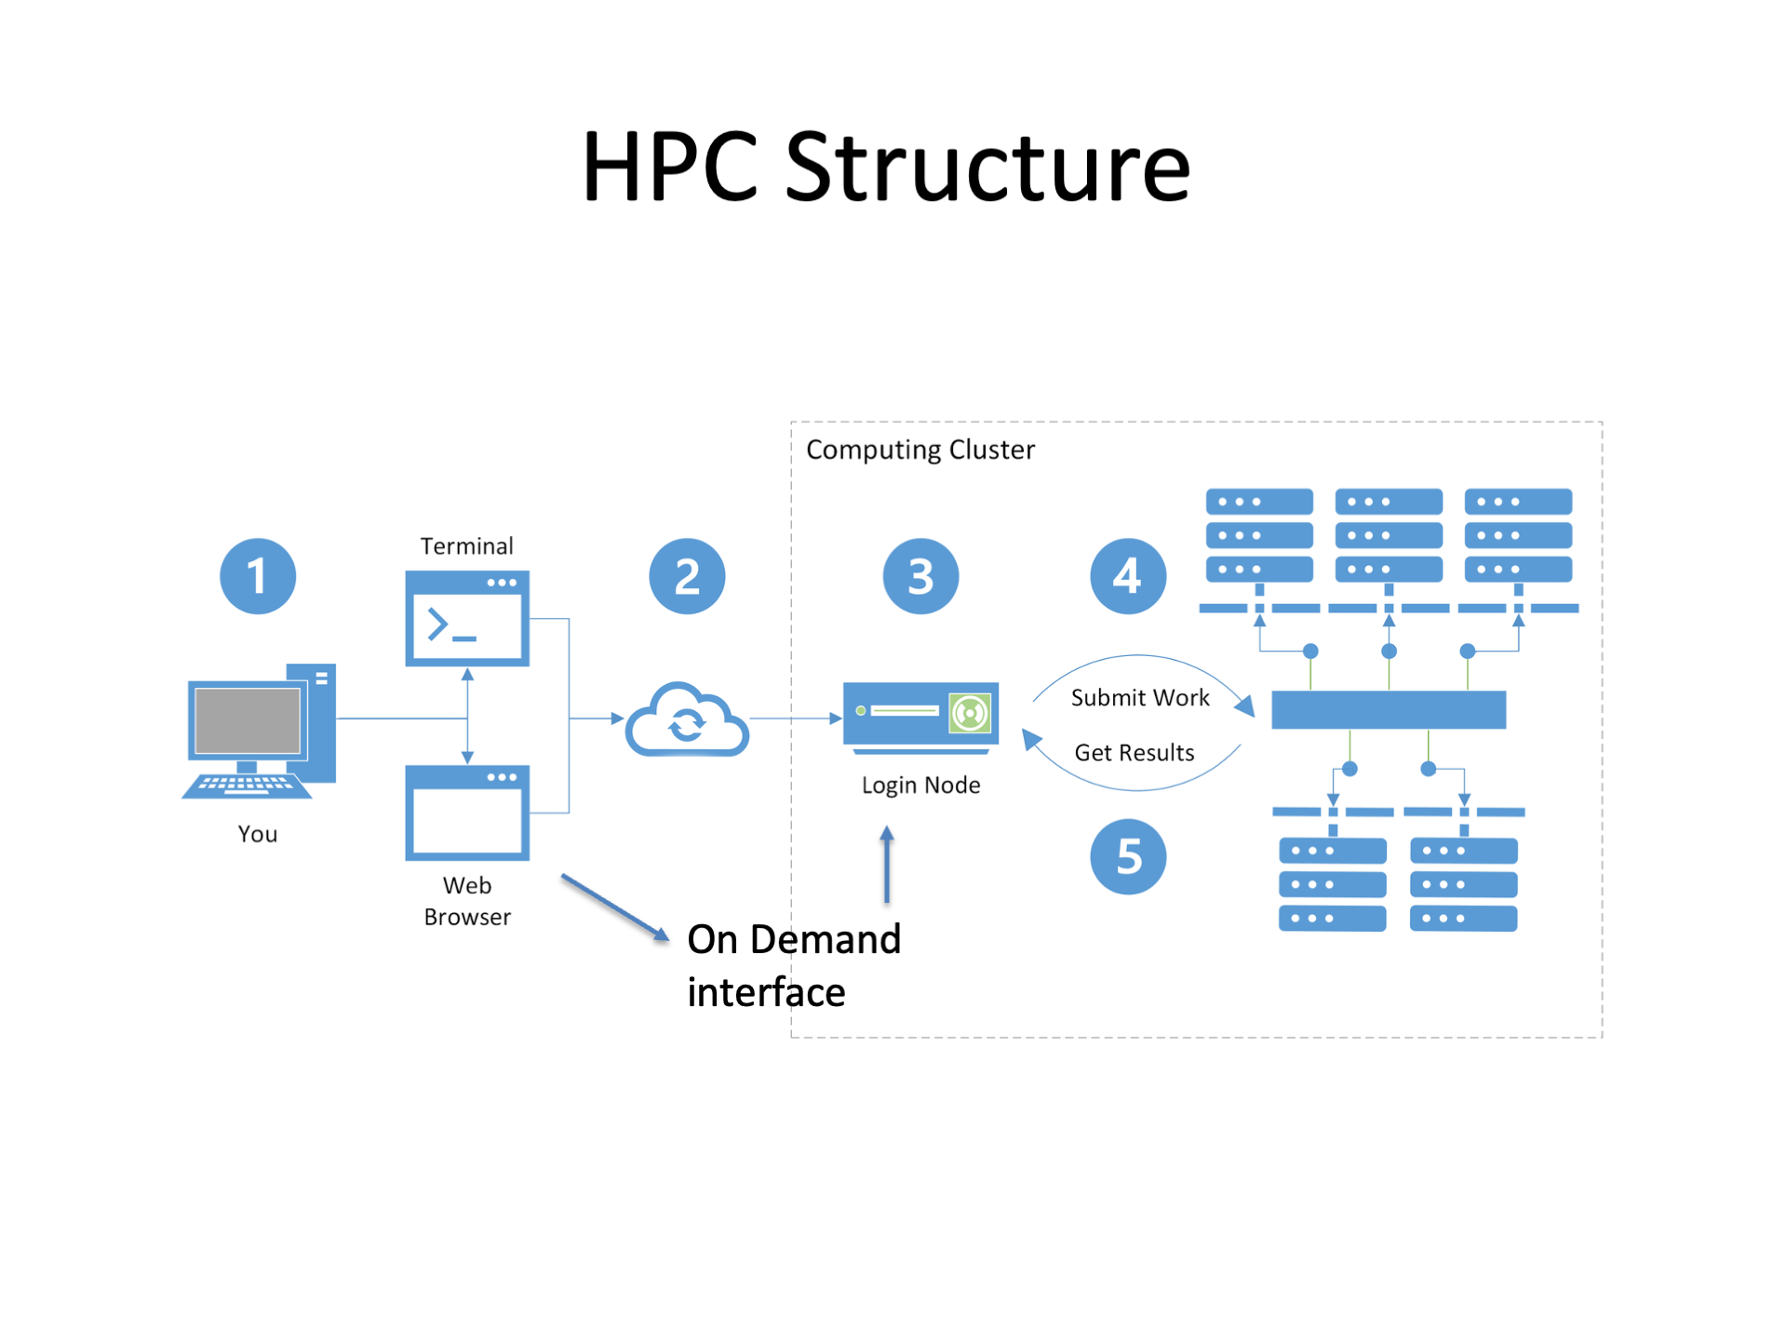
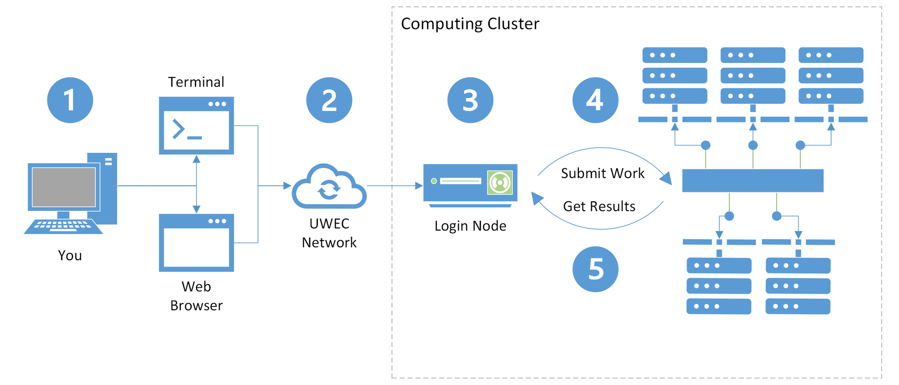
HPC Structure
On Demand interface

Slide 3


Regional HPC - Laguna

Slide 4
CARC’s OnDemand service provides users
Graphical, browser-based access to the Laguna HPC clusters and their /home1 and /project directories. OnDemand offers:
Easy file management
Command line shell access
Slurm job submission and management
Interactive applications, including Jupyter notebooks and RStudio Server

Slide 5
Use cases
OnDemand has a number of use cases that are not available with the traditional command-line interface to HPC resources:
File management with a graphical interface
Text editing with a graphical interface
Shell access with a web browser
Slurm job submission with a graphical interface
Interactive use of graphical apps
Development of code and notebooks with JupyterLab
Development of R code and notebooks with RStudio Server
Development of code with VS Code
High-performance and interactive data visualization

Slide 6
Sensitive data
Currently, CARC systems do not support the use or storage of sensitive data. If your research work includes sensitive data, including but not limited to HIPAA-, FERPA-, or CUI-regulated data, see our Secure Computing Compliance Overview or contact us at carc-support@usc.edu before using our systems.

Slide 7
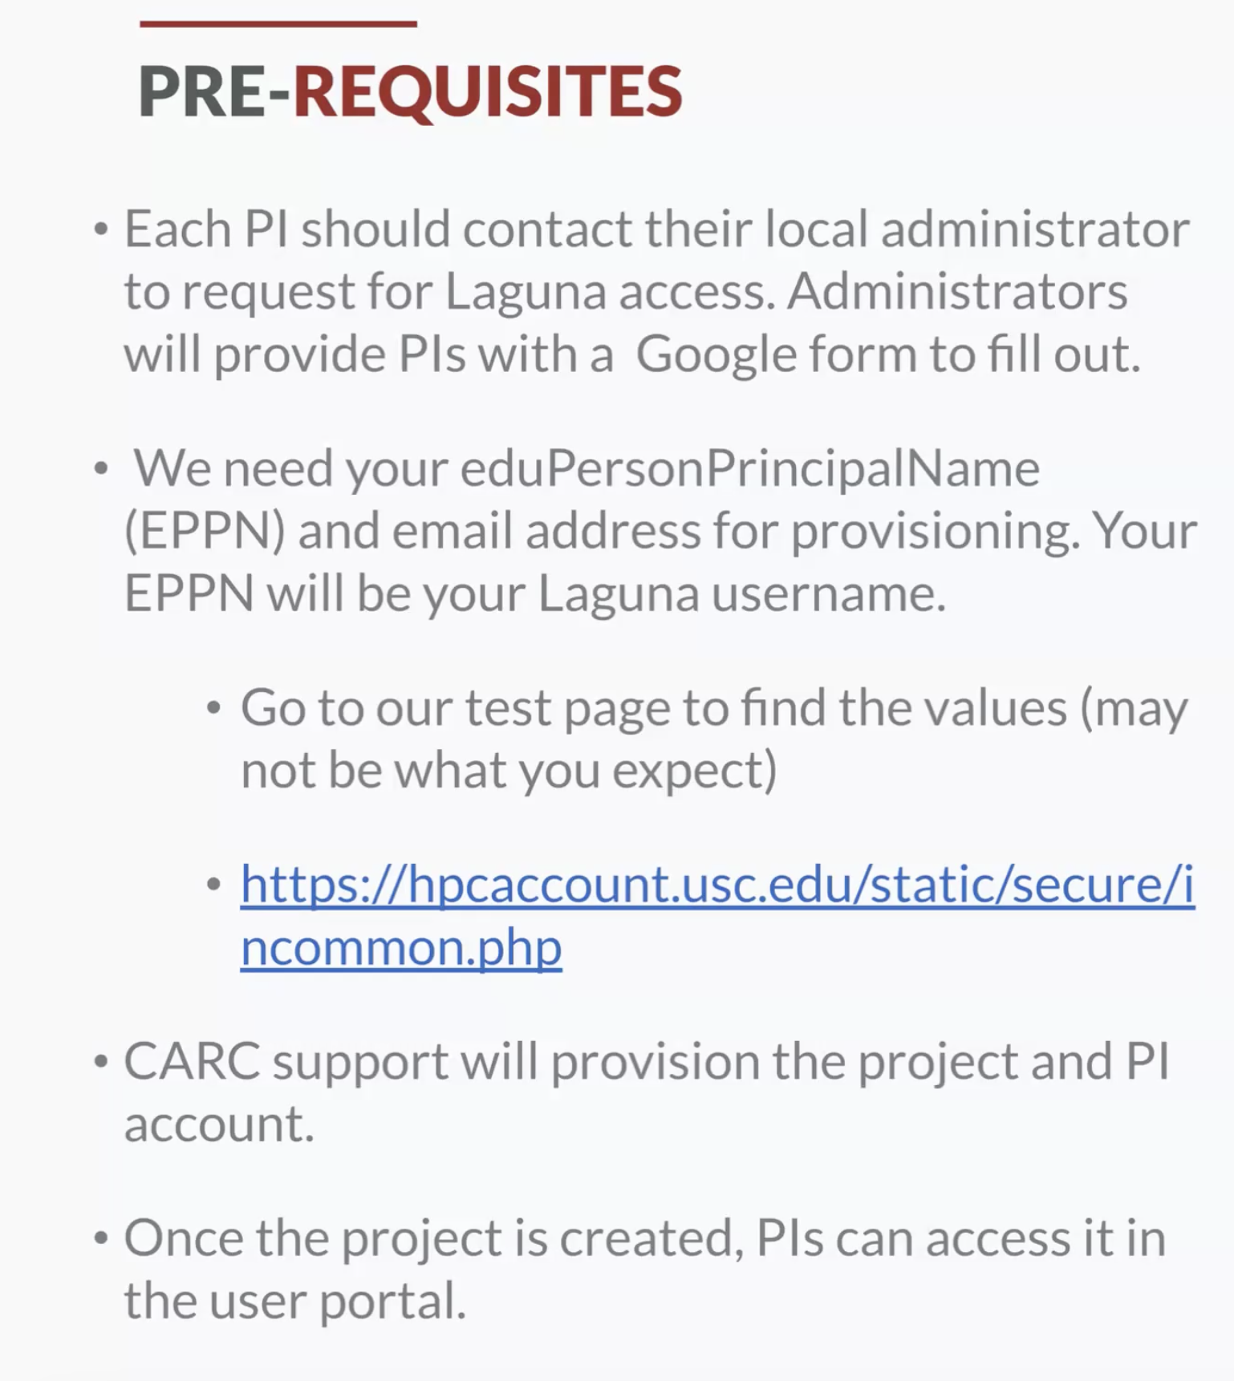

Slide 8
Workflow
The workflow for using Laguna typically consists of the following steps:
Connecting to the Internet
Logging in to the Laguna login node
Organizing files
Transferring files
Installing and running software
Testing your job interactively on a compute node
Submitting your job to the job scheduler to run it remotely on a compute node
Monitoring your job and checking the results when it has completed

Slide 9
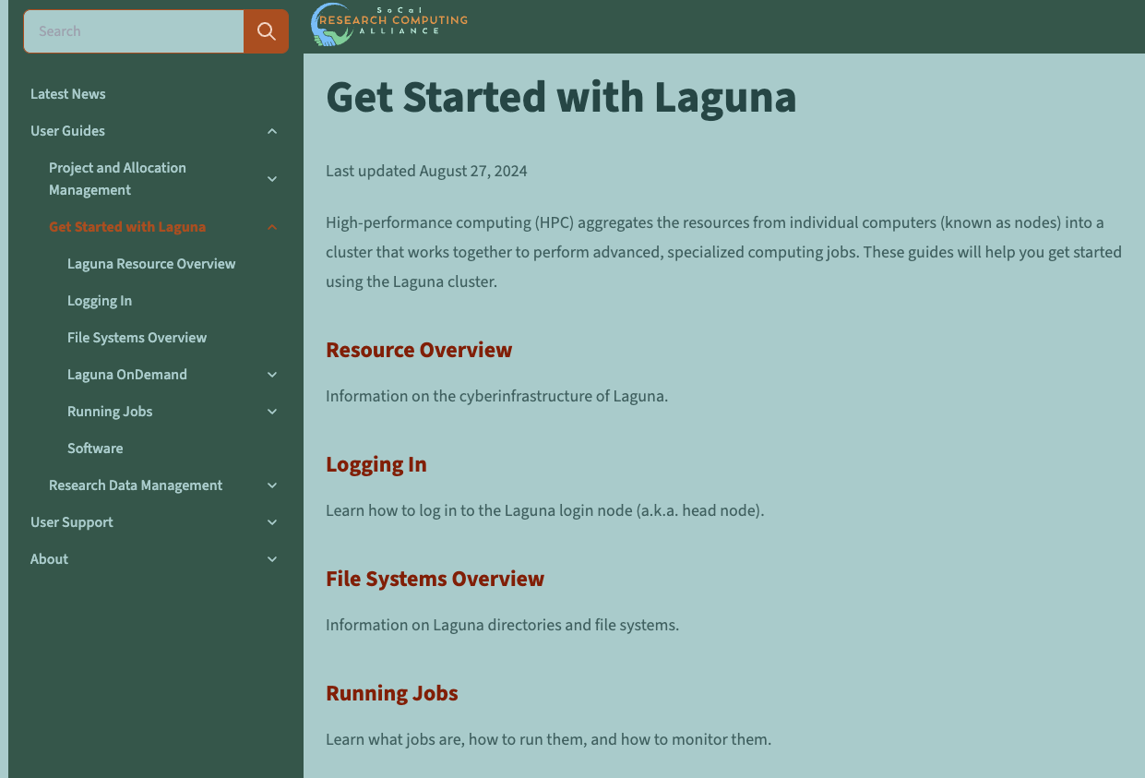
https://uschpc.github.io/regional-computing-website/user-guides/get-started-laguna.html
Resources

Slide 10
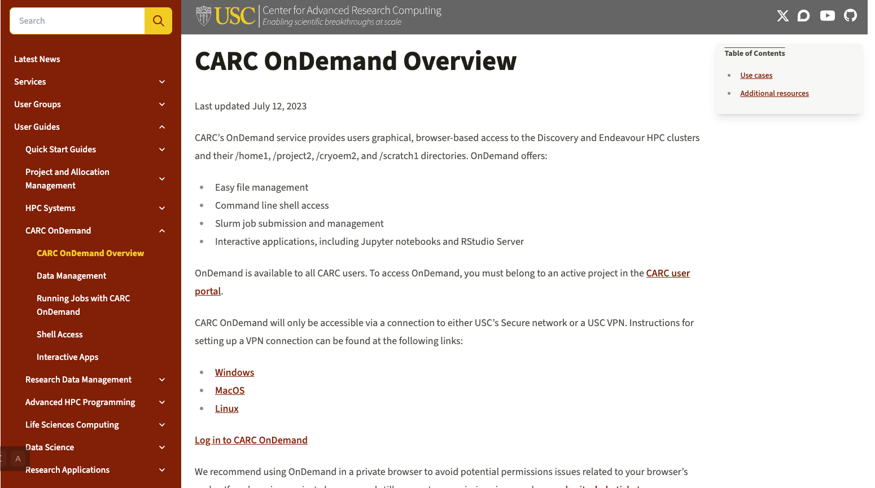
https://www.carc.usc.edu/user-guides/carc-ondemand/ondemand-overview
Resources

Slide 11
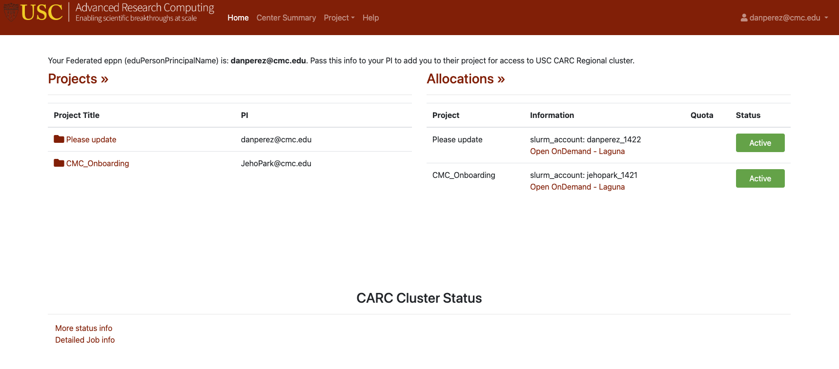
Hands on: Access your HPC account and find your project and allocation
https://hpcaccount.usc.edu/

Slide 12

Public and Private keys
Generating a key pair provides you with two long string of characters: a public and a private key. You can place the public key on any server and then unlock it by connecting to it with a client that already has the private key. When the two match up, the system unlocks without the need for a password. You can increase security even more by protecting the private key with a passphrase.

Slide 13
Create an RSA key pair
To create the key pair on your personal computer, open a shell session and follow the instructions:
$ ssh-keygen -t rsa -b 4096
This command prompts you to designate a location for the keys to be saved:
Enter file in which to save the key (/home/user_id/.ssh/id_rsa):
You can press enter here, saving the file to the default directory (e.g., /home/user_id/.ssh/id_rsa on macOS or Linux or C:\Users\user_id\.ssh\id_rsa on Windows).
Next is the passphrase prompt, provide a password for enhanced security:
Enter passphrase (empty for no passphrase):

Slide 14
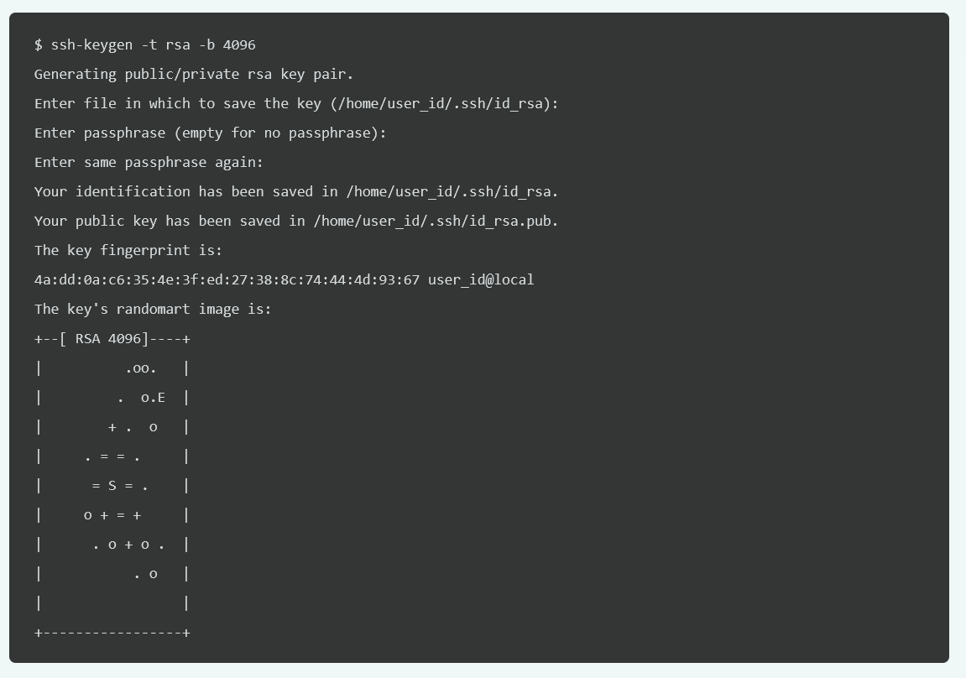
The entire key generation process looks something like this:

Slide 15

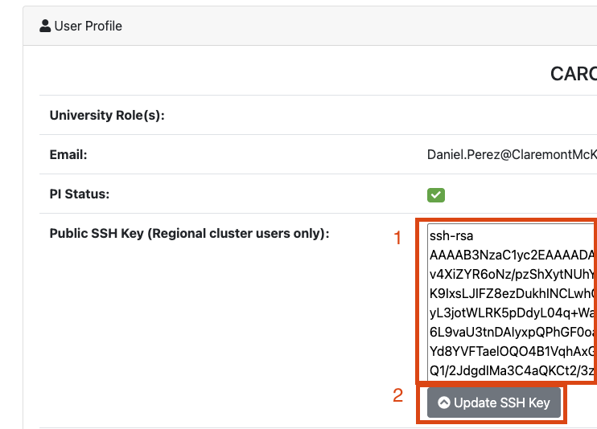
Hands On: Add public key to user portal
Once the keys are generated, copy the public key.
Mac OS:
cat ~/.ssh/id_rsa.pub | pbcopy
Windows:
cat ~/.ssh/id_rsa.pub
Navigate to the user portal and select your username in the top right corner to display the drop down menu. Select User Profile and paste your SSH key into the public SSH key field:

Slide 16



Data Encryption and Decryption
Public Key
Private Key
Hello
%$&1*
%$&1*
%$&1*
Hello
Encryption
Decryption

Slide 17
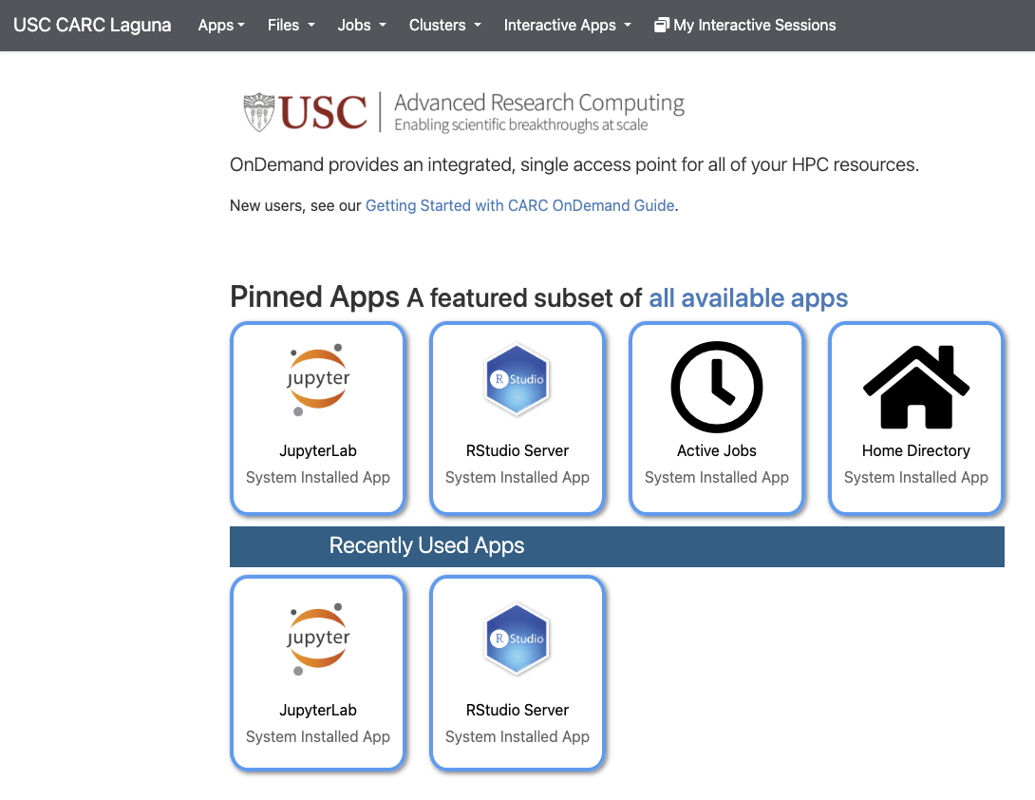
Laguna OnDemand
https://laguna-ood.carc.usc.edu/pun/sys/dashboard/

Slide 18
Interactive Apps
We currently offer JupyterLab, RStudio Server for Laguna, Code Server, RELION, and Shiny App access on both the Discovery and Endeavour clusters.
Other applications, such as Stata, Mathematica, and MATLAB, are available on the Traveler Desktop under the Interactive Apps dropdown (Not Laguna).

Slide 19
Running Jobs with CARC OnDemand
OnDemand provides two related job management tools. The Active Jobs tool allows you to monitor queued and running jobs and the Job Composer tool allows you to create and submit jobs via your web browser:
The Active Jobs tool will show you all jobs currently in the queue (running or queued), regardless of how the jobs were submitted.
Selecting Job Composer in the Jobs menu will open the Jobs page, where you can create new jobs and submit them to the cluster, and inspect the results of jobs submitted via this tool.

Slide 20
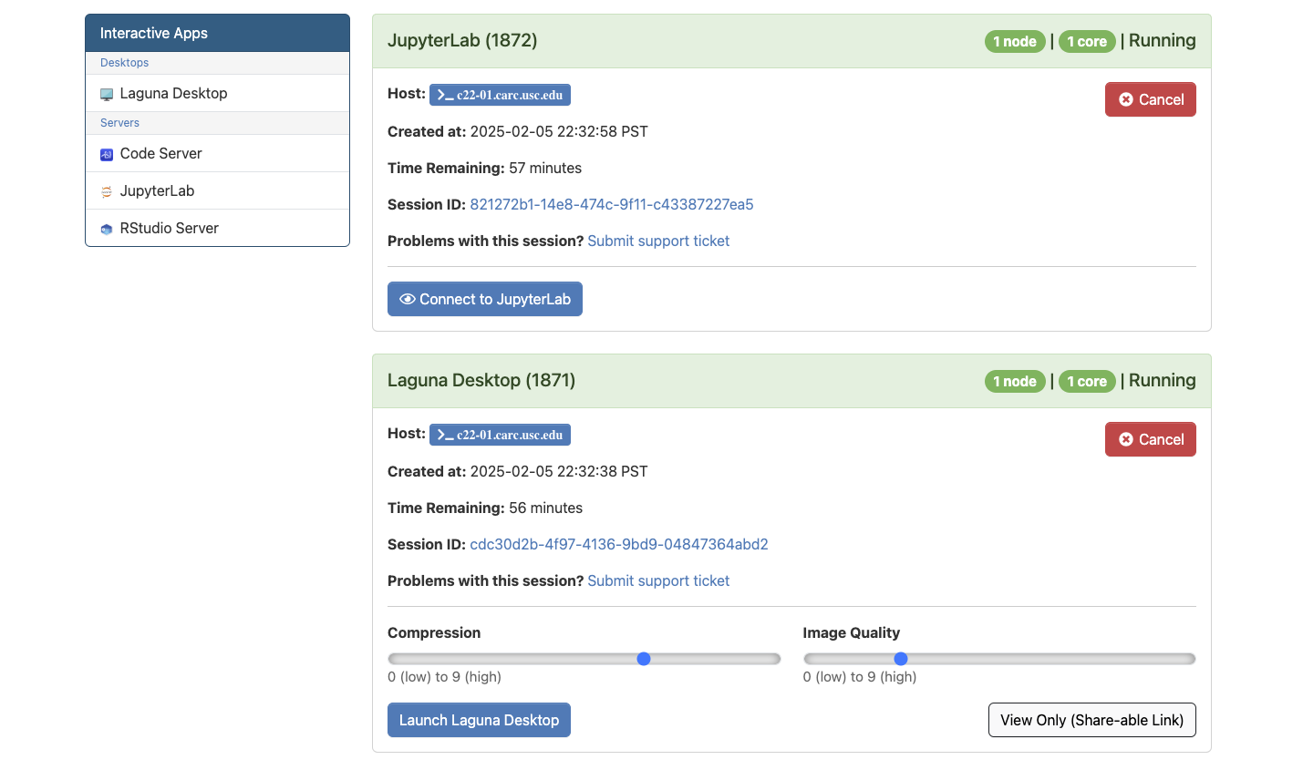
Interactive Apps
Running sessions

Slide 21
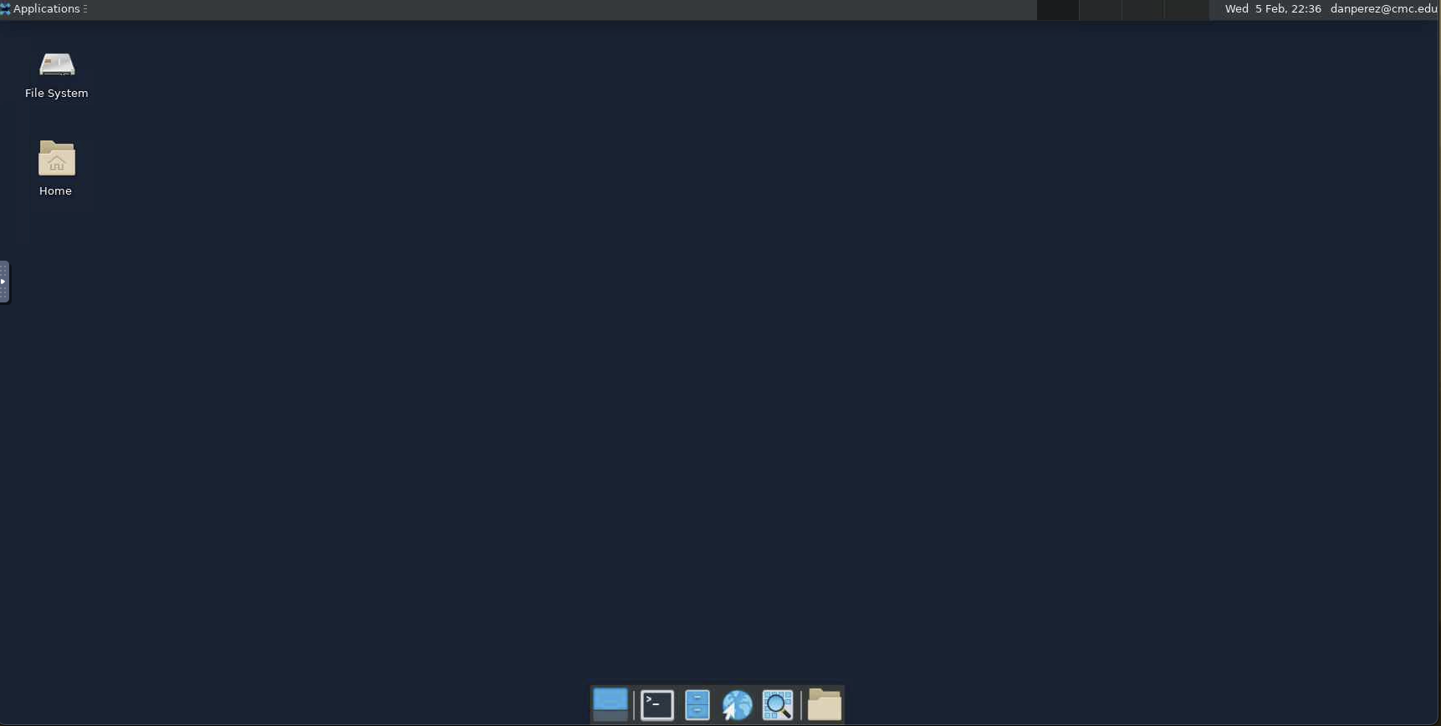

Slide 22
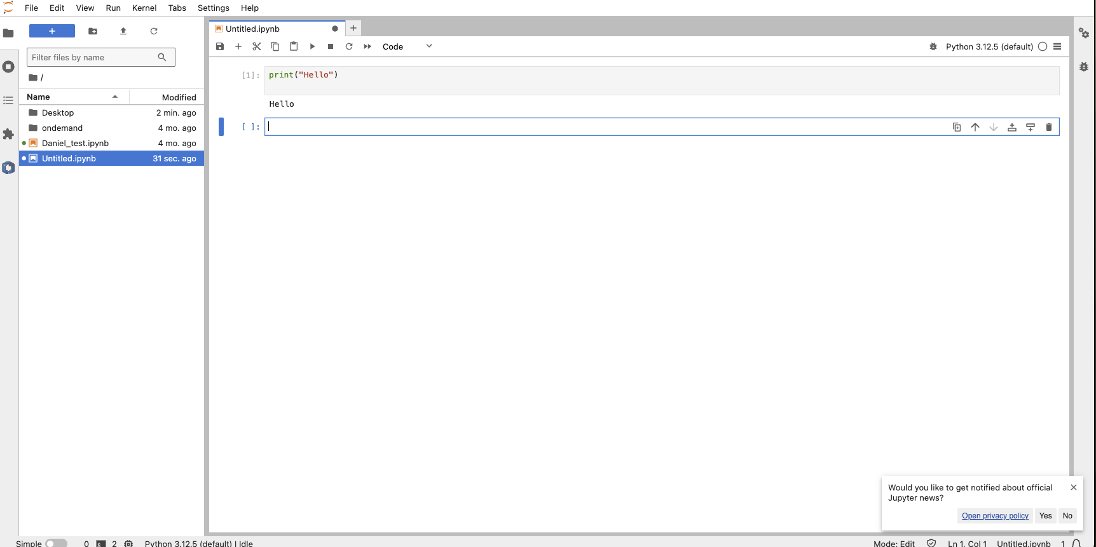

Slide 23
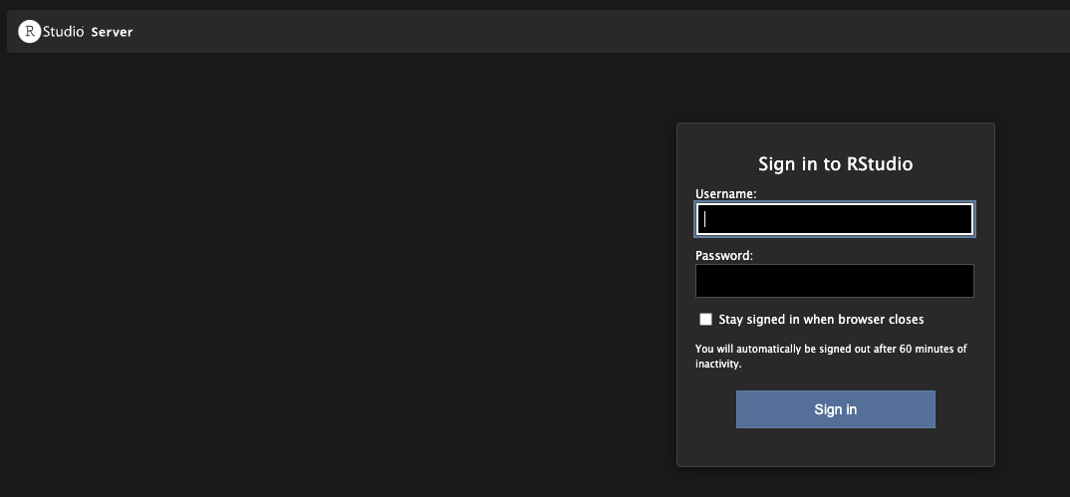

Slide 24
Hands on:
https://laguna-ood.carc.usc.edu/pun/sys/dashboard/
Access to On Demand and create three sessions:
Linux visual interface
Jupyter Notebook / R session
Shell access

Slide 25
Data Management
OnDemand provides a web-based file explorer that can be used to upload, download, copy, delete, rename, and edit data. OnDemand has quick links to your:
Laguna home directory (/home1/<Username>)
Laguna project directory (/project/<Project Name>)
Laguna scratch directories (/tmp ?)

Slide 26
Uploading and downloading files
OnDemand provides a basic file upload/download feature. However, this should be reserved for relatively small files (e.g., scripts and log files). For larger files, use one of the applications described in our transfer guides.
There are several ways to upload files. The first is to simply navigate to the desired destination directory in OnDemand, and then drag the file from your local computer to the OnDemand browser window. You can also click the “Upload” button to open a dialog that will allow you to navigate your local computer and select which files you want to upload:
To download files, select the file(s) in the OnDemand directory that you wish to download, and then use the blue Download button. You can select multiple files by holding down the Shift or Ctrl (or Command on a Mac) key as you select the files. If you select multiple files or a folder, OnDemand will zip the files and download a single .zip archive to your computer.

Slide 27
Transferring files
Different ways of transferring a file:
CARC GUI
Globlus
Terminal (SSH connection)

Slide 28
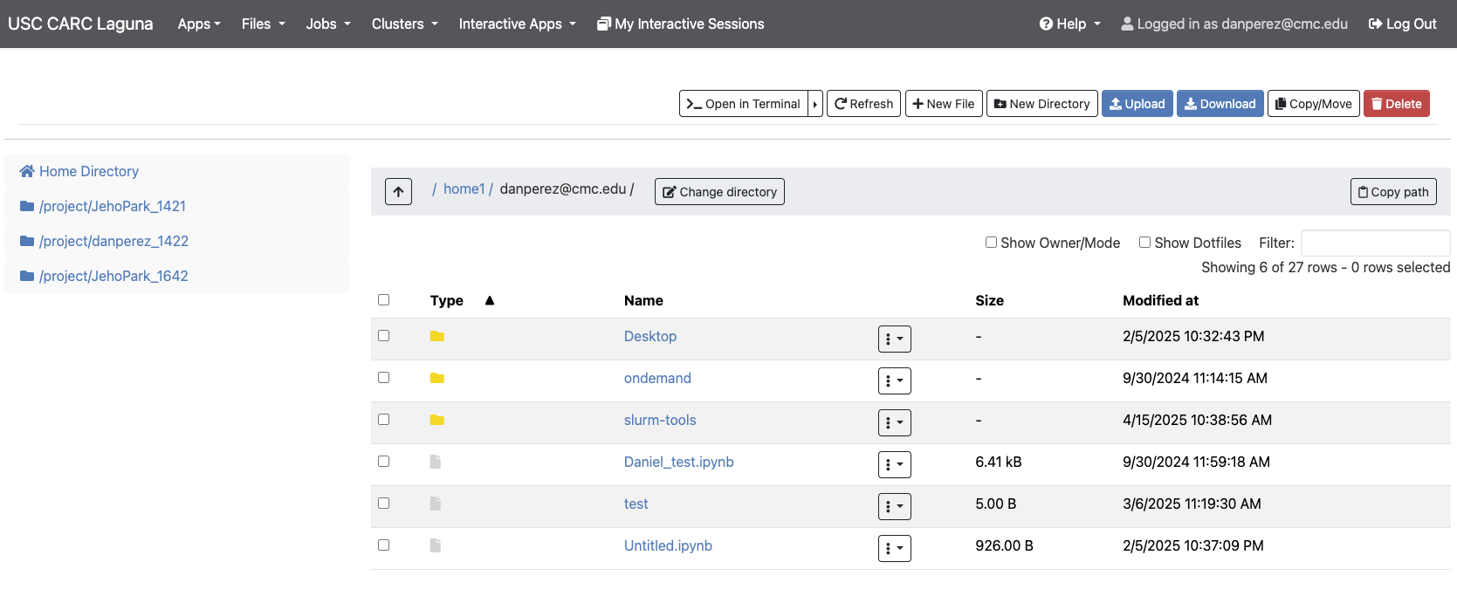
Hands on:
Copy some files to your project directory using the graphical interface

Slide 29
File operations
Most file operations can be accomplished by selecting a file in the File Explorer and choosing the desired operation from the main menu:
You have the ability to perform the following file operations in OnDemand:
View
Edit
Rename/Move
Download
Copy
Paste
(Un)Select All
Delete

Slide 30
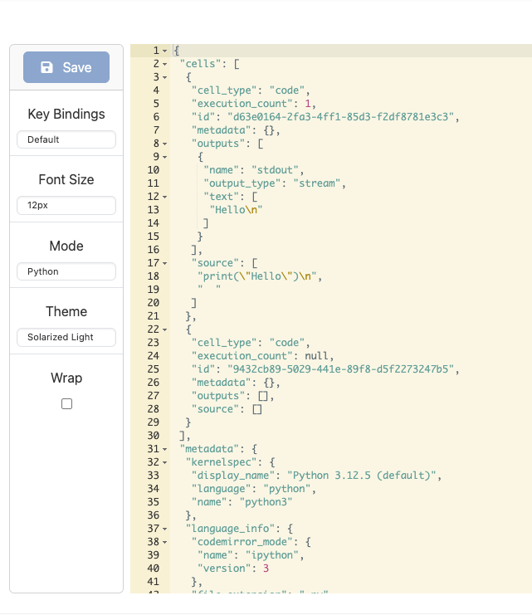
Hands on: Creating and editing text files
You can always create files on your personal computer and transfer them to Discovery, but it is typically more efficient to create them directly on Discovery. Try using the GUI to create a script and change the editor mode to color the code and make edition easier.

Slide 31
Running jobs
A job consists of all the data, commands, scripts, and programs that will be used to obtain results. Because the Discovery computing cluster is a shared system, we use a job scheduler to manage all requests for resources. The Slurm (Simple Linux Utility for Resource Management) job scheduler is an open-source job scheduler that allocates compute resources on clusters for queued, user-defined jobs. It performs the following functions:
Schedules user-submitted jobs
Allocates user-requested compute resources
Processes user-submitted jobs
Running Jobs user guide

Slide 32
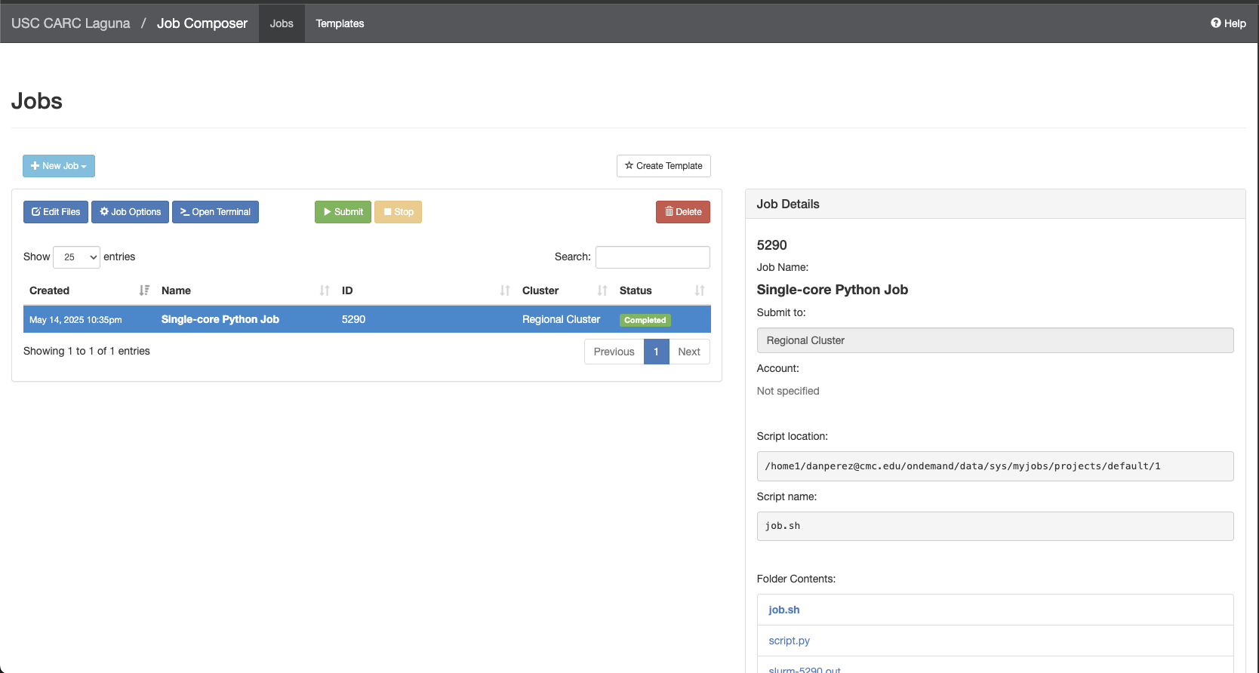
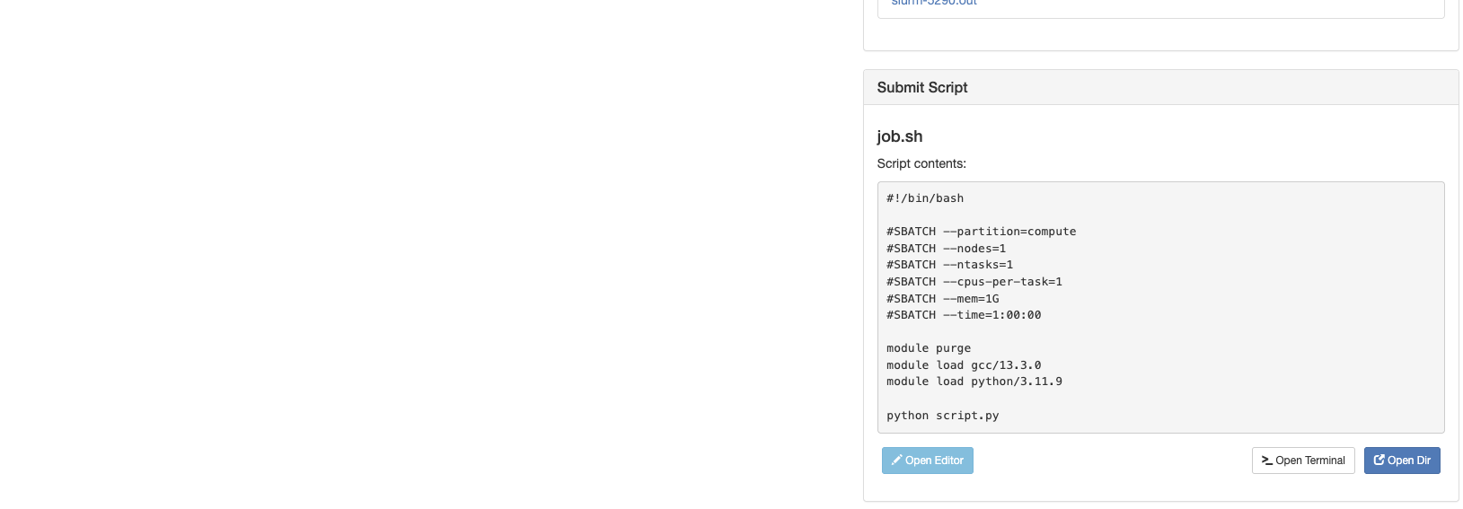
Hands on: Run Hello World and check results

Slide 33
Shell Access
OnDemand provides the ability to SSH into the Discovery and Endeavour clusters as well as a dedicated Data Transfer node.

Slide 34
Logging in
To log in to the Laguna login node (also known as the head node), you will need to use a secure shell client. This is a small application that enables you to connect to a remote computer via SSH (Secure SHell), a cryptographic network protocol for securely operating network services.
You will need your USC NetID to SSH into the login node and an SSH key assigned to your account and validated by CARC.

Slide 35
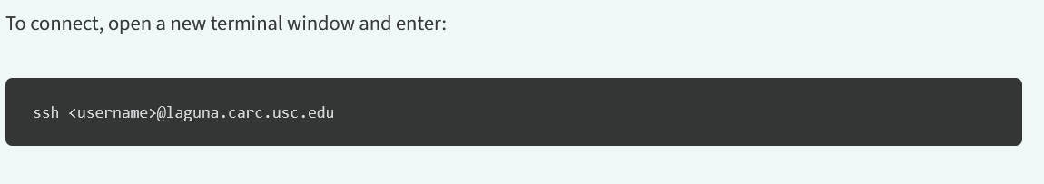
Hands on: SSH login

Slide 36
File operations
Create
View
Edit
Rename/Move
Download
Copy
Delete

Slide 37
Creating and editing text files
You can edit text files in the shell console. For plain-text files, you can use the micro, nano, vim, or emacs text editors. We recommend the Micro editor for new users; Vim and Emacs both have steeper learning curves, but you may eventually find them more useful and productive. By default, only vi is installed on the HPC.

Slide 38
Copy files to project folder
For this command to work you must exit the ssh and work form your local computer
$scp local_file_path <username>@laguna.carc.usc.edu:<destination_path>

Slide 39
Installing and running software
On Discovery, CARC maintains software, compilers, and libraries using the module system. These may satisfy your computing requirements without any further installations.
To see the list of available software, enter the command:
$ module avail
To load software based on this list, such as Julia, enter the command:
$ module load julia

Slide 40
Creating and submitting Slurm job scripts Cheat Sheet
https://www.carc.usc.edu/user-guides/hpc-systems/using-our-hpc-systems/slurm-cheatsheet

Slide 41
Hands On: Parallel GIS: Zonal Statistics with MPI
High Performance Computing for Geospatial Data
Vanessa Casillas| SP’2025 | HPC Workshop

Slide 42
Download a repository
$git clone https://github.com/

Slide 43
Why HPC for GIS?
• Geospatial datasets (like satellite imagery, DEMs) are large
• Operations like zonal statistics can be slow
• HPC enables:
- Faster processing
- Larger coverage areas
- Efficient memory use

Slide 44
Zonal Statistics Project
• Objective: Compute mean elevation from a DEM (GeoTIFF)
• Use mpi4py to parallelize over multiple processors
• Each process handles a chunk of the raster
• Results combined at the end
• Input: dem.tif | Output: Average Elevation (meters)

Slide 45
Zonal Statistics Explained
• Zonal statistics: Calculate metrics (mean, min, max) for each zone in a raster
• In this case: the entire raster = one zone
• Common in:
- Land use analysis
- Environmental modeling
- Urban planning

Slide 46
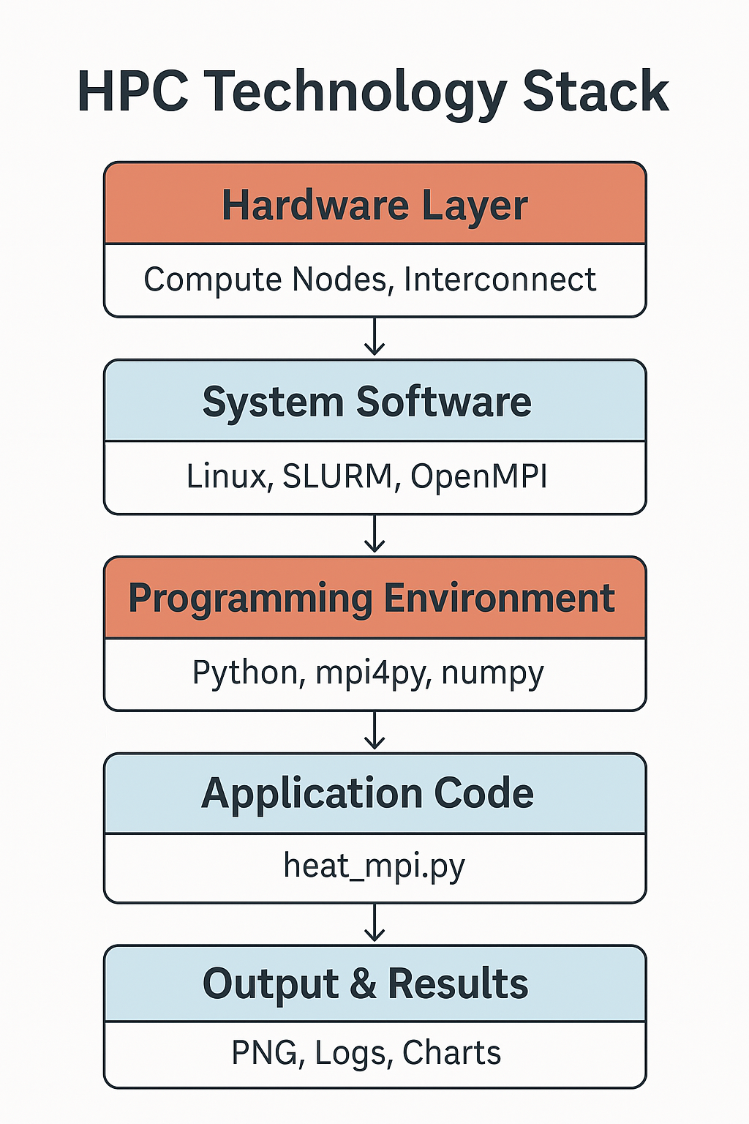
HPC Technology Stack

Slide 47
Create a session
Hands On
salloc --partition=gpu --gres=gpu:1 --cpus-per-task=8 --mem=32GB --time=1:00:00
Load Conda Module
Conda is the package and environment manager that installs, runs, and updates packages and their dependencies.
Module purge
Module load conda
Initialize shell to use Conda and Mamba
mamba init bash
source ~/.bashrc

Slide 48
Create a virtual environment
mamba create --name <env_name>
Check environments info
conda info --envs
Activate the environment
Mamba activate <env name>
Install packages into the environment
mamba install pytorch torchvision torchaudio pytorch-cuda=11.8 -c pytorch -c nvidia
Type ‘python’ and verify the packages by importing them
Import torch

Slide 49
Hands On: Create a project environment and Install Modules
• Python
• mpi4py – parallel processing
• rasterio – reading GeoTIFF files
• numpy – data handling
• SLURM or mpiexec – job scheduler (HPC)
• Easy to reproduce and modify for other GIS tasks

Slide 50
Parallel Processing Strategy
• Load raster on root process
• Divide rows equally among MPI processes
• Each process computes local mean
• Use MPI.Reduce to compute global average

Slide 51
Code Highlight – MPI Logic
rows_per_proc = shape[0] // size
start = rank * rows_per_proc
end = (rank + 1) * rows_per_proc
local_data = data[start:end, :]
local_mean = np.mean(local_data[local_data != nodata])
global_mean = comm.reduce(local_mean, op=MPI.SUM, root=0)

Slide 52
Running on HPC
• Script: zonal_mpi.py
• Run with:
mpiexec -n 4 python zonal_mpi.py
• Or via SLURM:
sbatch run_zonal.sh

Slide 53
Run Batch and get Results
Job status
squeue -u <username>
• Check Output file:
Average Elevation: 543.27 meters

Slide 54
Closing a HPC Project
Downloading
Temp Files
Deleting Project

Slide 55
Key Takeaways
• HPC is powerful for processing big GIS data
• mpi4py makes parallelization accessible in Python
• Raster-based zonal statistics scale easily with more cores
• Can extend to NDVI, land cover, or terrain classification

Slide 56
Resources
https://www.carc.usc.edu/user-guides/carc-ondemand
https://uschpc.github.io/regional-computing-website/user-guides/get-started-laguna/logging-in.html
Additional resources
OnDemand documentation

